Slide 1
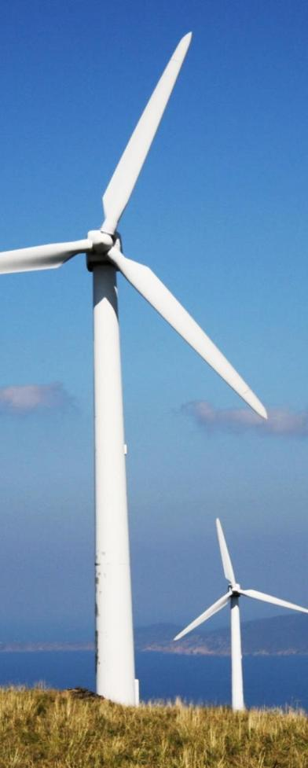
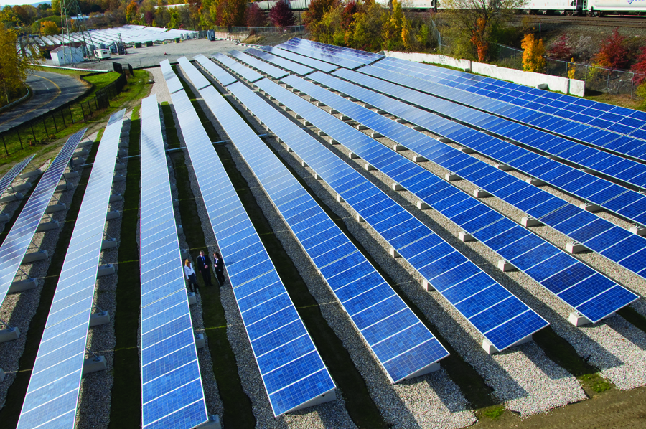
RE-Powering America’s Land:
Siting Renewable Energy on Potentially Contaminated Land, Landfills and Mine Sites

Slide 2
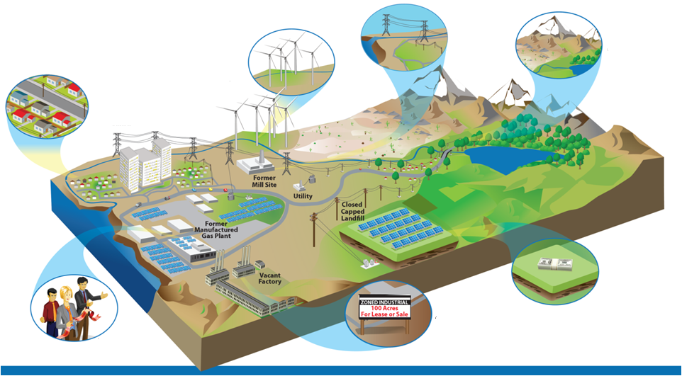
Why Renewables on Potentially Contaminated Lands
Leverage existing
infrastructure
Build sustainable land development strategy
Protect open
space
Provide low-cost, clean power to communities
Improve project economics through reduced land costs & tax incentives
Reduce project cycle times with streamlined zoning and permitting
Gain community support

Slide 3
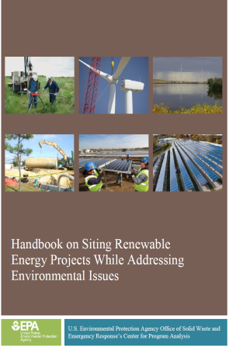
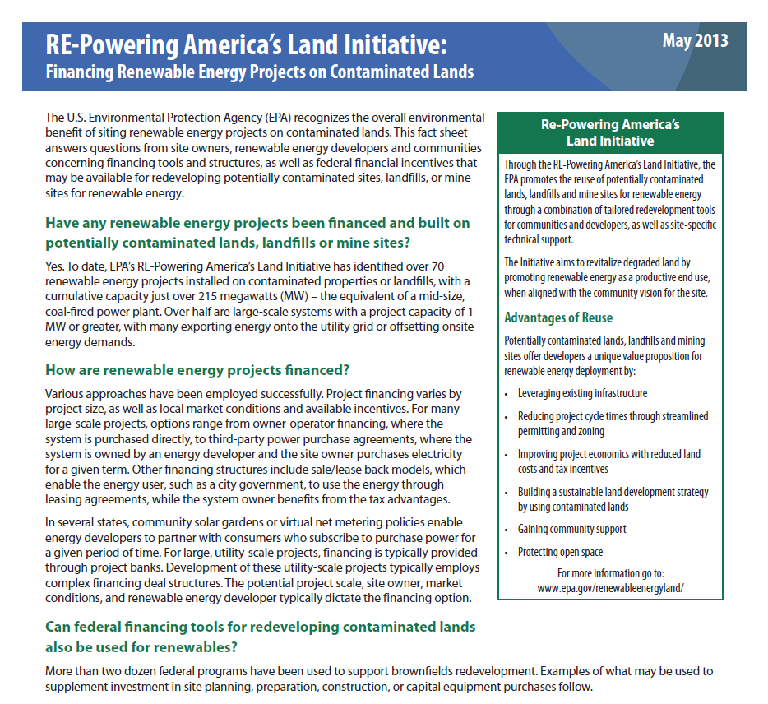
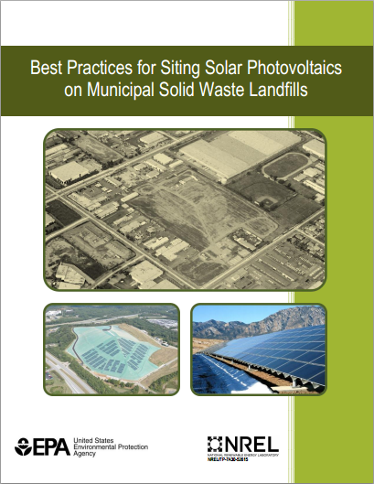
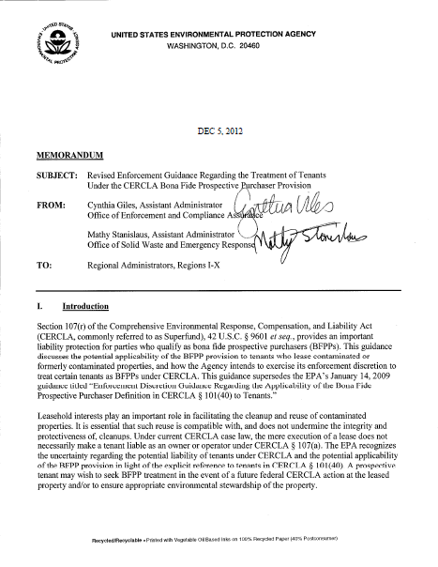
Redevelopment Tools and Resources
Notes:
Handbook on Siting Renewable Energy Projects…
Goal
Emphasize that RE projects may occur during several phases of cleanup
Provide key considerations for integrating RE
into cleanup processes
The following tools are included
Checklists
Maps
Solar and wind decision trees
Best Practices for Siting Solar PV on MSW Landfills
Provides overview of Solar PV Systems
Provides unique considerations, challenges, and best practices for siting solar PV on MSW landfills
Provides information on power generation and deal structures
Provides examples of solar PV on landfill projects
Provides tools and resources to help facilitate solar PV on landfills

Slide 4
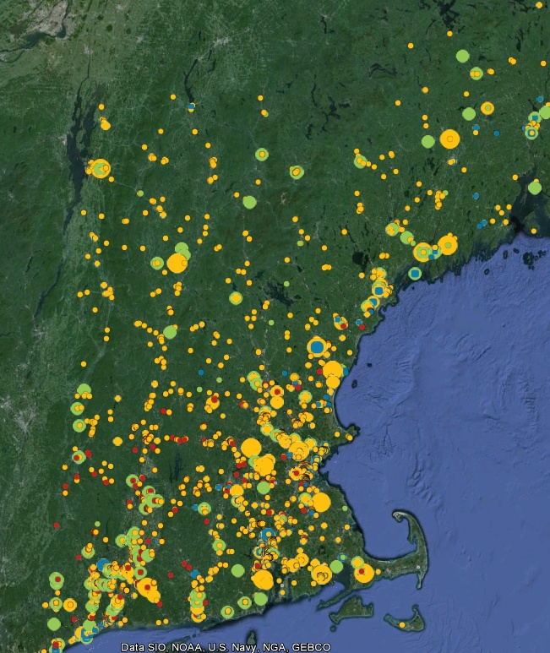
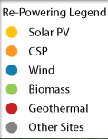
RE-Powering Mapper
Google Earth Overlay
Mapped inventory of 80,000+ EPA and select state tracked sites (over 43 million acres of land)
Incorporates data from:
EPA Cleanup and Landfill Programs
National Renewable Energy Lab
  Wind, Solar, and Biomass Resources
Southern Methodist University and USGS
  Geothermal
Department of Homeland Security
  U.S. Highways
  Railroads
  Transmission Lines
  Substations
State Agencies from CA, HI, IL, MA, NJ, NY, OR, PA, TX, VA, and WV

Slide 5
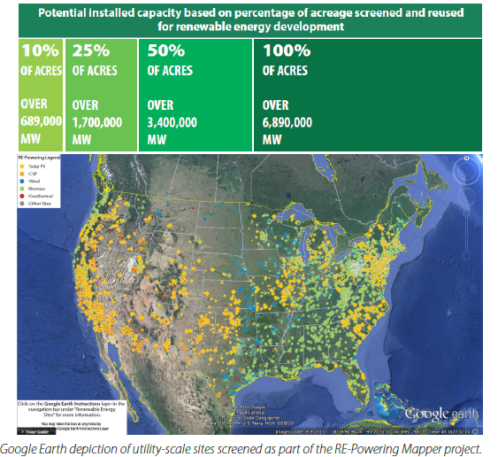
Potential Power Generation Capacity

Slide 6
Sites in RE-Powering Mapper
Sites Associated with Federal Programs | # of Sites
Abandoned Mine Land | 466
Brownfield Program Sites | 26,030
Superfund | 2,009
Landfills - Landfill Methane Outreach Program | 2,062
RCRA Corrective Action Sites (i.e., sites that require hazardous waste permits) | 3,759
 | 34,326
State Identified Sites | # of Sites
California (7,622), Hawaii (1,180), Illinois (5,541), Massachusetts (1,495), New Jersey (10,362), New York (2,180), Oregon (4,743), Pennsylvania (5,543), Texas (1,150), Virginia (5,422), West Virginia (2,103) | 47,341
Total Federal and State Sites in the Mapper | 81,667
10,000 sites in California

Slide 7
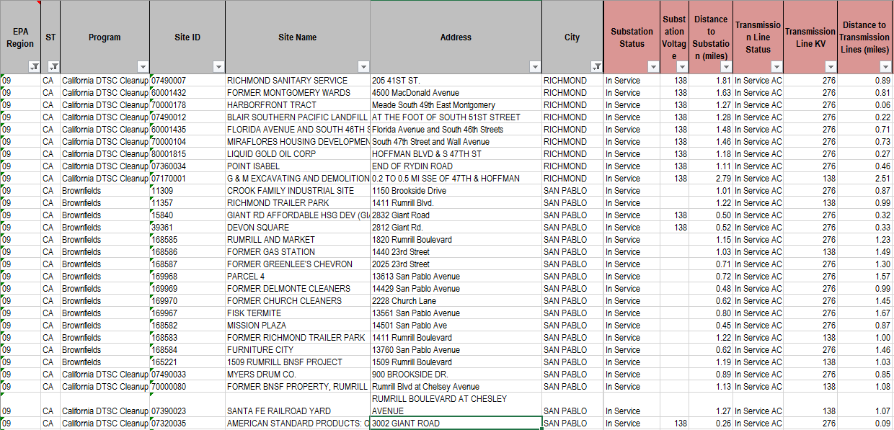
Sample of site listings and pre-screening info

Slide 8
State-Managed Site Databases
California Dept. of Toxic Substances Control (DTSC)
Brownfields and Hazardous Waste Sites
Envirostor
www.envirostor.dtsc.ca.gov/public/
State Water Resources Control Board
Sites that impact groundwater
GeoTracker
http://geotracker.waterboards.ca.gov/
CalRecycle
Landfills
Solid Waste Information System (SWIS)
www.calrecycle.ca.gov/SwFacilities/Directory/

Slide 9
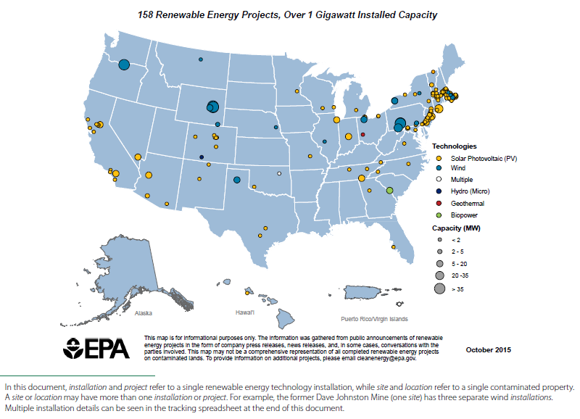
158 Installations Identified To Date
1,069.7 MW
Notes:
Most Installations -- Sell wholesale electricity;
are sited on landfills; and are located in policy supportive states
Most Installations -- Sell wholesale electricity;
are sited on landfills; and are located in policy supportive states

Slide 10
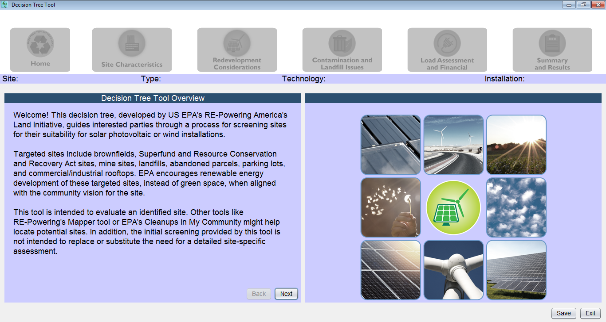
RE-Powering’s Electronic Decision Tree
Purpose: To screen sites for suitability for a solar PV or wind energy project

Slide 11
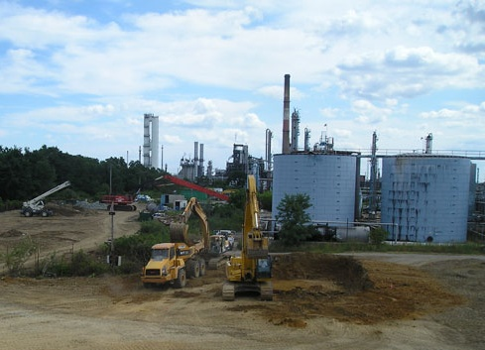
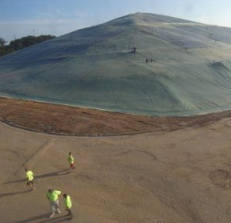
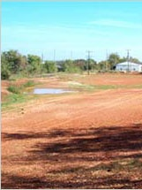
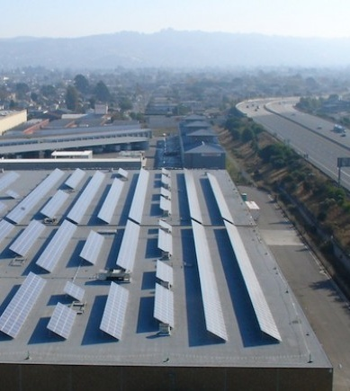
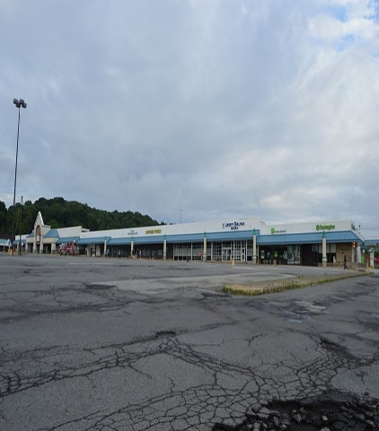
RE-Powering’s Electronic Decision Tree
Key Stakeholders
Targeted Sites
Potentially Contaminated or Underutilized Sites
State & Local Governments and Non-Profit Organizations
To screen and prioritize existing sites in communities for their suitability for a renewable energy installation
Renewable Energy Developers
To introduce considerations unique to redevelopment of potentially contaminated sites and provide a common framework for interactions with state and local governments during project development phase
Clean-up Project Managers
To facilitate site screening by sharing tool with owners or operators of potentially contaminated sites and other interested parties
Brownfields, Superfund sites, mines, or sites permitted to manage hazardous waste
Landfills
Underutilized rooftops and parking lots
Abandoned parcels

Slide 12
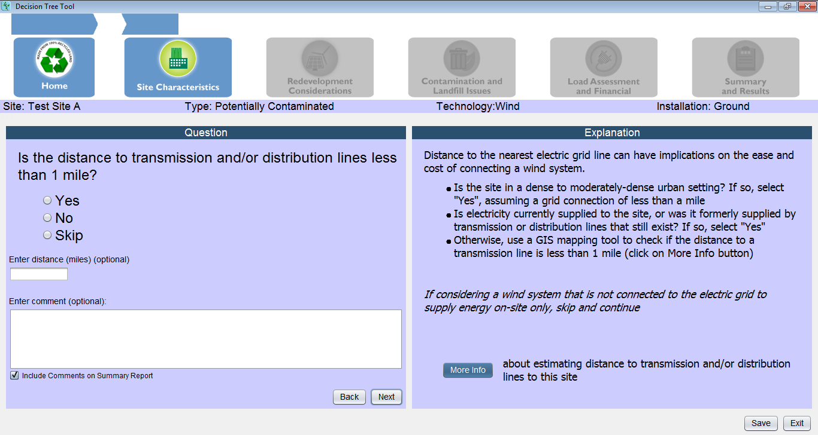
RE-Powering’s Electronic Decision Tree
Walks users through key considerations with a series of
Yes / No / Skip Questions
Supplements questions with additional information, tips, and links to relevant resources
Generates reports of the screening results, including user annotations, that can be printed or imported into other documents

Slide 13
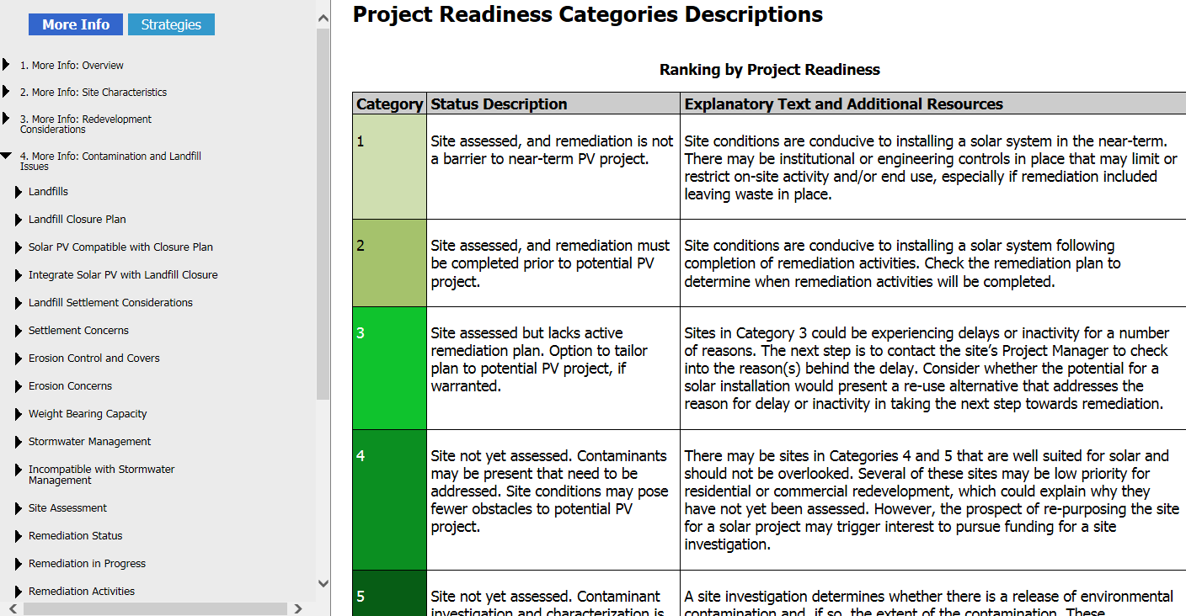
RE-Powering’s Electronic Decision Tree
More Info Guide Snapshot

Slide 14
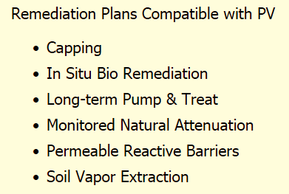
Considerations for Brownfields
General Tips
Sites that have been assessed for contaminants and cleaned up (or where clean-up is not required) are good candidates for a near-term RE project
Sites that have a long-term cleanup plan that doesn’t disturb the surface are also good candidates for a near-term RE project

Slide 15
Considerations for Brownfields
General Tips
A portion of a large site might be suitable for RE even if cleanup activity is occurring on other parts
The prospect of a RE project could motivate local action to apply for funds for site assessment and cleanup

Slide 16
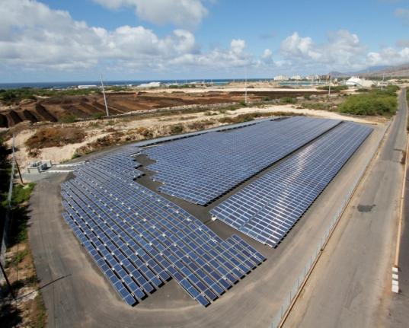
Considerations for Landfills
Landfill closure status
Other land use restrictions
Settling
Compatibility with
  piping / collection systems
  leachate and landfill gas system
Erosion control, stormwater management

Slide 17
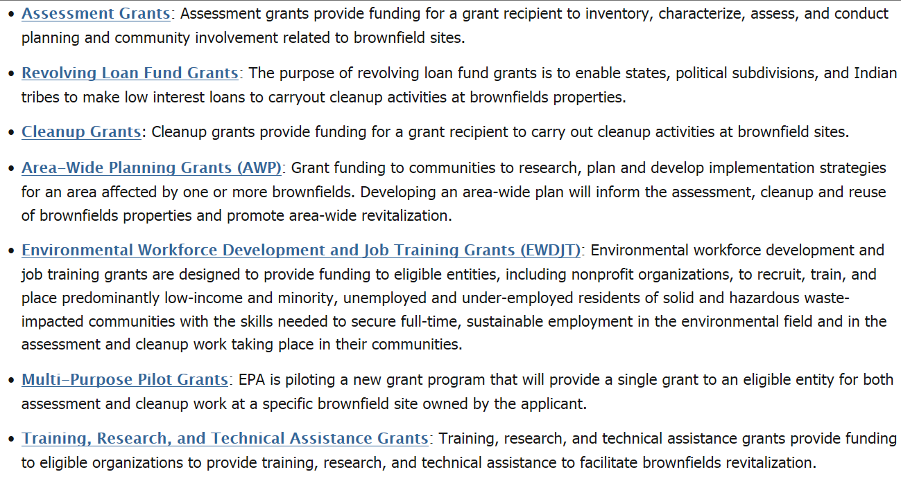
EPA Brownfields Grants Opportunities
www.epa.gov/brownfields/apply-brownfields-grant-funding

Slide 18
How Can EPA Help?
Demonstrate RE-Powering site identification & screening tools
Facilitate connections to State Project Managers for sites that are locally screened
  Groundwork needed to gather info on sites; will likely involve connecting to State oversight agencies
    California Dept. of Toxic Substances Control
    Regional Water Quality Control Board
Lend other support
  E.g., point to successful RE projects on landfills and remediated sites, clarify liability

Slide 19
RE-Powering America’s Land
        www.epa.gov/re-powering
      Karen Irwin
      Sustainable Local Government Lead,
      EPA Region 9, Land Division
        irwin.karen@epa.gov
        (415) 947-4116

